Slide 1

Lesson 1:
You Live on Turtle Island
1 | 3
Objective: Students will be able to identify and interpret images and themes from art and literature, in order to tell the meaning of climate justice in their own words.

Slide 2


Key Terms
 | 3
Symbol: A word, image, character, or object that has multiple layers of meaning
Lenape: The original inhabitants of Lenapehoking before European colonization, and their descendants. Today, there are many different Lenape communities, including the Ramapough Lenape, the Nanticoke Lenni-Lenape, the Delaware Lenape Nation, and more.
Symbol
Lenape
Interpretation
Interpretation: One person’s explanation of the overall meaning of a work of art or literature
Turtle Island: Native American name for the continent of North America (including Canada, Mexico, the United States, and other countries)
Turtle Island
Lenapehoking: Lenape name for the Delaware River watershed (including parts of Pennsylvania, Delaware, New Jersey, New York, and Maryland)
Lenapehoking

Slide 3
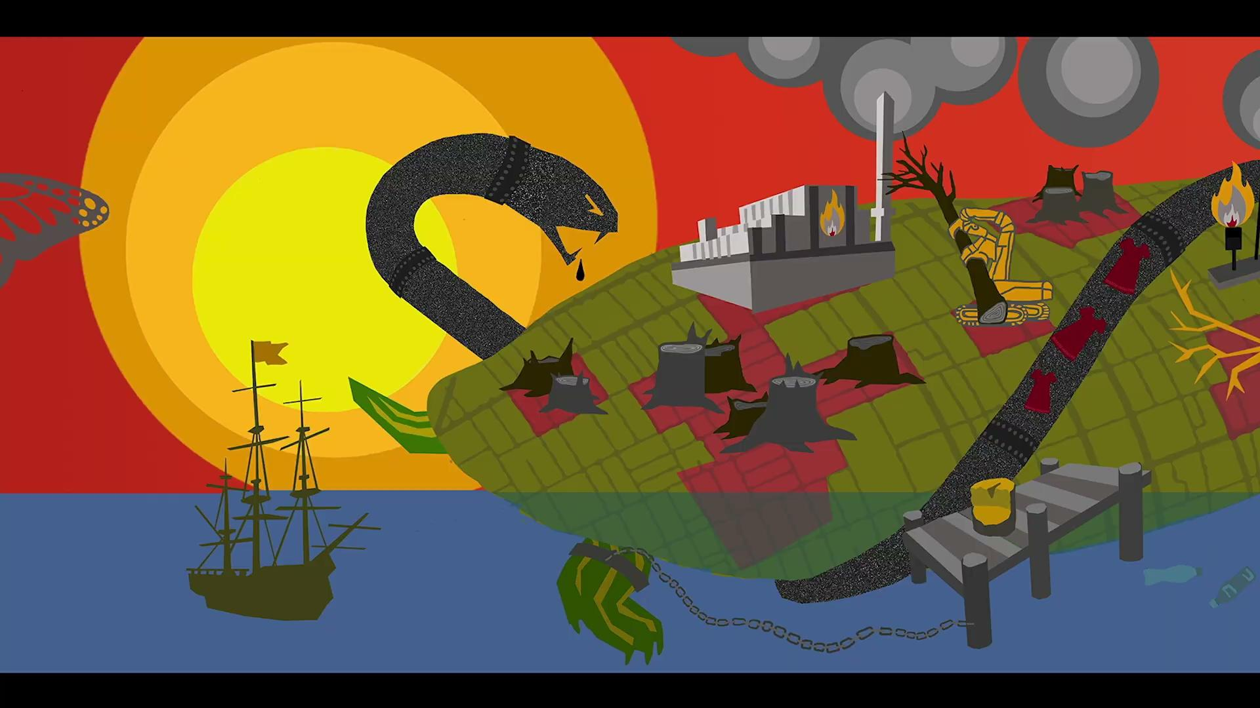
THINK - PAIR - SHARE
Observe the animated image silently
 |  | 5 | 7 | 9 | 11 | 13 | 15 | 17 | 19 | 21

Slide 4
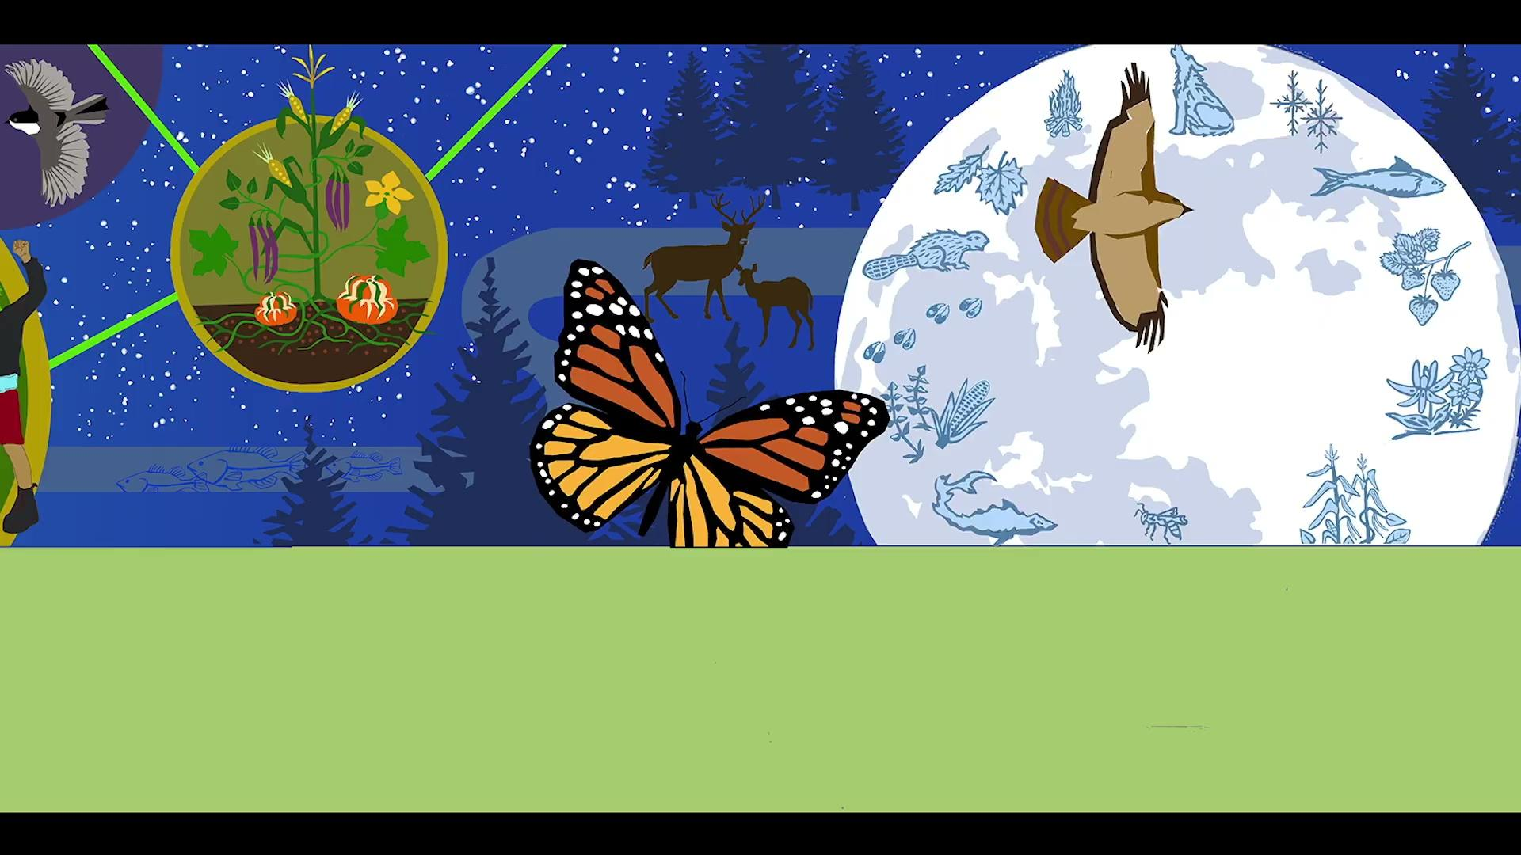
THINK - PAIR - SHARE
Discuss with a partner. “What symbols do you see in this image? What do you think they might represent?”
 |  |  | 7 | 9 | 11 | 13 | 15 | 17 | 19 | 21

Slide 5
THINK - PAIR - SHARE
One person from each pair reports back to the class.
 |  |  |  | 9 | 11 | 13 | 15 | 17 | 19 | 21
“One symbol we saw was __________________________.
We think this might represent ______________________
because ___________________________________________.”
“Another symbol we saw was _______________________.
We think this might represent _______________________
because ___________________________________________.”

Slide 6
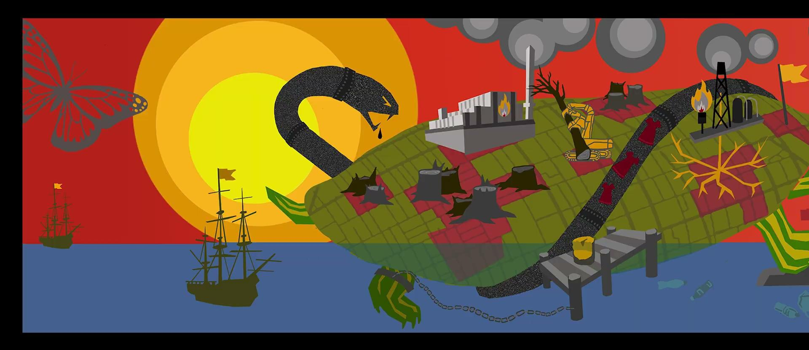
PAIR - SHARE
Discuss with a partner. “How do you feel when you see these symbols, and why?”
 |  |  |  |  | 11 | 13 | 15 | 17 | 19 | 21

Slide 7
PAIR - SHARE
One person from each pair reports back to the class.
 |  |  |  |  |  | 13 | 15 | 17 | 19 | 21
“When we see the __________________________________,
we feel _____________________________________________
because ____________________________________________.”

Slide 8
PAIR
Discuss with a partner. “What questions do you have about this image?”
 |  |  |  |  |  |  | 15 | 17 | 19 | 21

Slide 9
SHARE
One person from each pair reports back to the class.
 |  |  |  |  |  |  |  | 17 | 19 | 21
Some questions we have about this image are:
Who _________________________________________?
What ________________________________________?
Where _______________________________________?
When ________________________________________?
Why _________________________________________?
How _________________________________________?

Slide 10
PAIR
Discuss with a partner. “What do you think the artists who designed this image were trying to communicate?”
 |  |  |  |  |  |  |  |  | 19 | 21

Slide 11
SHARE
One person from each pair reports back to the class.
 |  |  |  |  |  |  |  |  |  | 21
“We think the artists who designed the image were trying to communicate _______________________________________
_______________________________________________________________________________________________________________________________________________________________________”

Slide 12

Lenape Creation Story
 |  |  |  |  |  |  |  |  |  |  | 22 | 23 | 24 | 25 | 27
“It must be stated that there are differing Nanticoke and Lenape creation stories that are well documented to the 17th and 18th centuries.
Sadly, some that are being widely circulated today in modern publications are not historic, but are the modern invention of cultural enthusiasts and not the product of an authentic tribal community’s tradition. Those collected here are from historically well documented tribal communities…”
From the Nanticoke Lenape Museum, nanticokelenapemuseum.org

Slide 13

Lenape Creation Story
 |  |  |  |  |  |  |  |  |  |  |  | 23 | 24 | 25 | 27
“Of the historically documented accounts, one of the earliest recorded tells of how a Lenape elder answered the inquiry of a Dutchman who wanted to know where the Lenape people came from… He was silent for a little while, either as if unable to climb up at once so high with his thoughts, or to express them without help. Then, he took a piece of coal out of the fire where he sat, and began to write upon the floor.”
From the Nanticoke Lenape Museum, nanticokelenapemuseum.org

Slide 14

Lenape Creation Story
 |  |  |  |  |  |  |  |  |  |  |  |  | 24 | 25 | 27
“He first drew a circle, a little oval, to which he made four paws or feet, a head and a tail. ‘This,’ he said, ‘is a tortoise, lying in the water around it.’ He moved his hand round the figure continuing: ‘This was or is all water, and so at first was the world or the earth, when the tortoise gradually raised its round back up high, and the water ran off of it, and thus the earth became dry.”
From the Nanticoke Lenape Museum, nanticokelenapemuseum.org

Slide 15

Lenape Creation Story
 |  |  |  |  |  |  |  |  |  |  |  |  |  | 25 | 27
“He then took a little straw and placed it on end in the middle of the figure and proceeded, ‘The earth was now dry, and there grew a tree in the middle of the earth, and the root of this tree sent forth a sprout beside it, and there grew upon it a man, who was the first male. This man was then alone, and would have remained alone; but the tree bent over until its top touched the earth, and there shot [out] another root, from which came forth another sprout, and there grew upon it the woman, and from these two are all men produced.’”
From the Nanticoke Lenape Museum, nanticokelenapemuseum.org

Slide 16

Lenape Creation Story
THINK
How does this story impact your interpretation of the whole mural image?
SHARE
Raise your hand to share with the class.
 |  |  |  |  |  |  |  |  |  |  |  |  |  |  | 27

Slide 17
“Change for Climate is Here”
video and exit slip
Read the questions on your exit slip:
 |  |  |  |  |  |  |  |  |  |  |  |  |  |  |  | 29 | 39 | 45
What / where is Turtle Island?
What / where is Lenapehoking?
Describe a symbol in the image that the video taught you more about. What is the symbol, and what else did you learn about it?
Which had the greatest impact on you: the image, the creation story, or the video? Explain why.
After watching the video, what new questions do you have?
Based on everything you learned in class today, come up with a title for the image. Why did you choose this title?

Slide 18

“Change for Climate is Here”
video and exit slip
Watch the video:
 |  |  |  |  |  |  |  |  |  |  |  |  |  |  |  |  | 39 | 45

Slide 19
“Change for Climate is Here”
video and exit slip
Answer the questions on your exit slip:
 |  |  |  |  |  |  |  |  |  |  |  |  |  |  |  |  |  | 45
What / where is Turtle Island?
What / where is Lenapehoking?
Describe a symbol in the image that the video taught you more about. What is the symbol, and what else did you learn about it?
Which had the greatest impact on you: the image, the creation story, or the video? Explain why.
After watching the video, what new questions do you have?
Based on everything you learned in class today, come up with a title for the image. Why did you choose this title?

Slide 20


End of Lesson 1:
Thank You!

